Slide 1
NETFLIX ANALYSIS DASHBOARD
Date - 10/06/2023
Author - Sarvagha K
Tool - Tableau

Slide 2
INTRODUCTION
Welcome to the Netflix Analysis Dashboard presentation!
Netflix, the world's leading streaming service, offers an extensive collection of TV shows and movies.
In this presentation, we will explore the power of our Netflix Analysis Dashboard, which provides comprehensive insights into Netflix's content library.

Slide 3
OVERVIEW
The Netflix Analysis Dashboard is a powerful tool designed to analyze TV shows and movies available on Netflix.
It leverages advanced data analytics and visualization techniques to provide actionable insights for content creators, producers, and decision-makers.

Slide 4
DASHBOARD

Slide 5
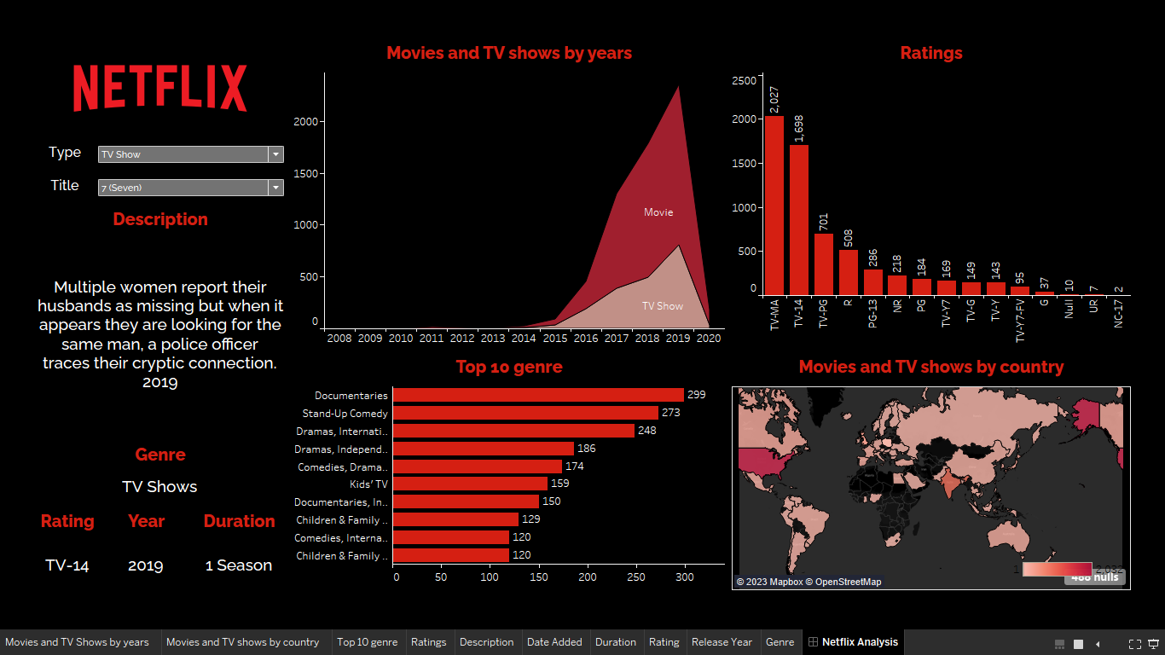

Slide 6
ANALYSIS

Slide 7
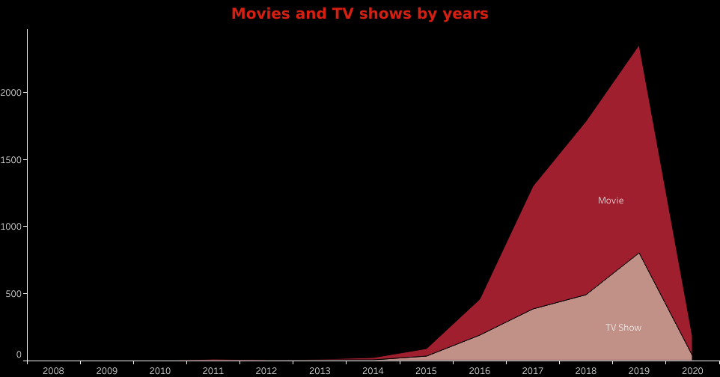
Movies and TV shows by years

Slide 8
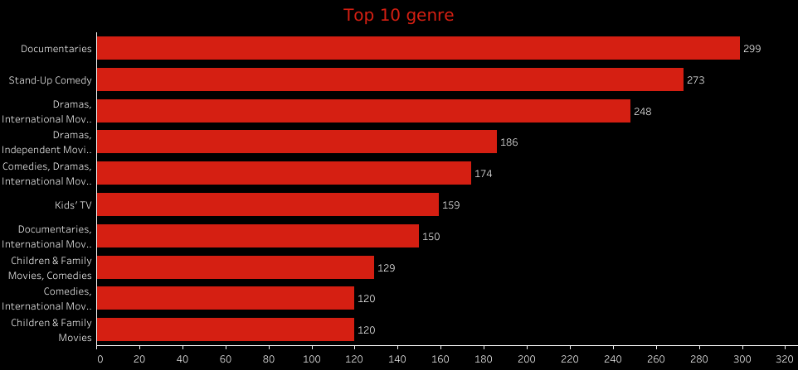
TOP 10 Genre

Slide 9
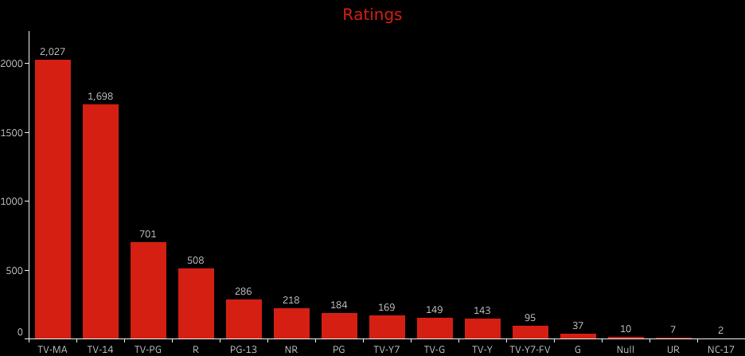
Ratings

Slide 10
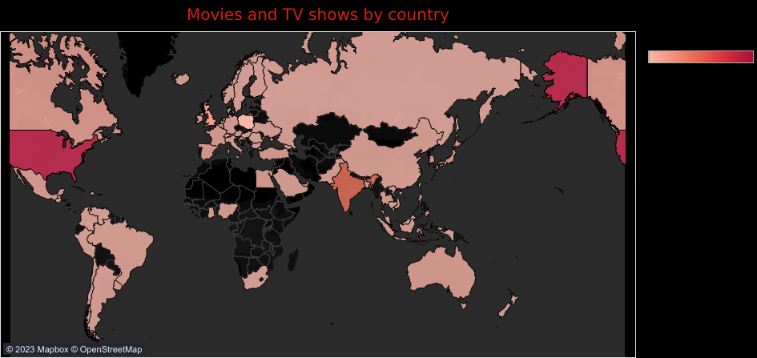
Movies and TV shows by country

Slide 11
Dashboard - Link
TABLEAU -https://public.tableau.com/app/profile/sarvagha.k7909/viz/NetflixAnaysisDashboard/NetflixAnalysis

